Slide 1
Installation Guide
(JDK – JDK 6 Update 14)
2009. 07. 21
CODELABOR

Slide 2
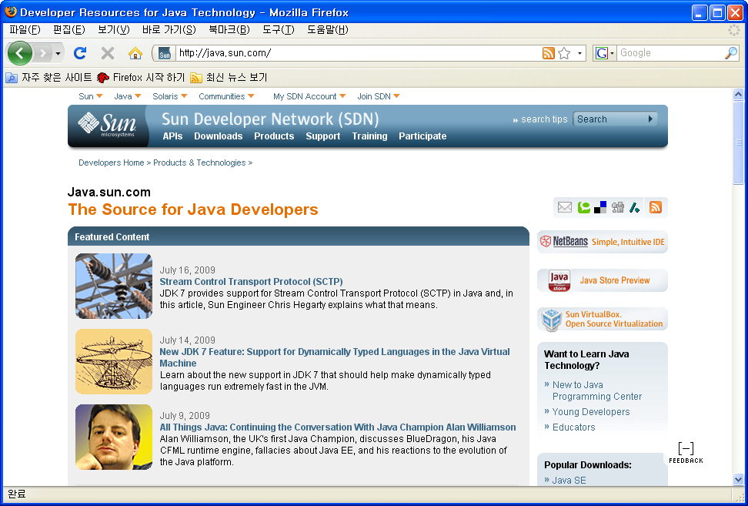
JDK
Site
Official Site: http://java.sun.com

Slide 3
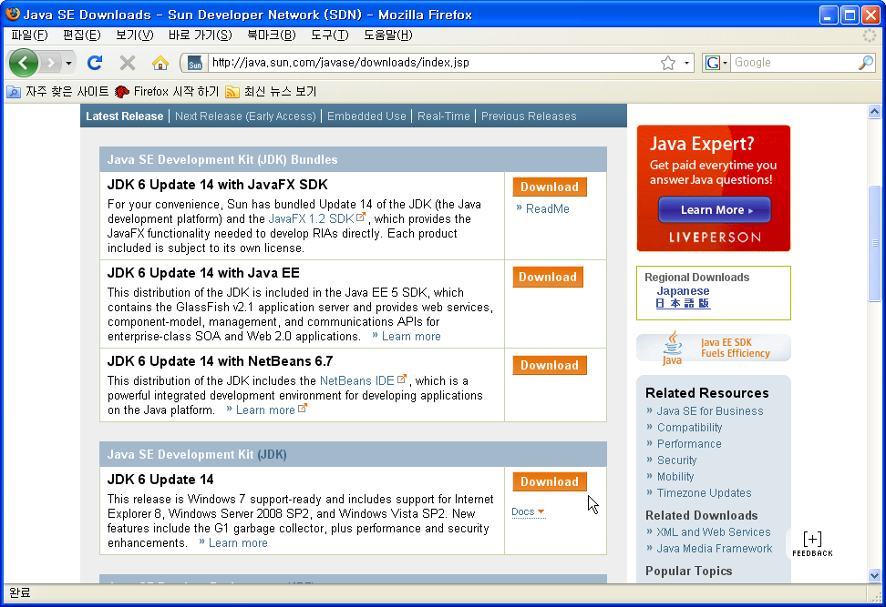
JDK
Download
Download Site URL: http://java.sun.com/javase/downloads/index.jsp
Package: JDK 6 Update 14

Slide 4
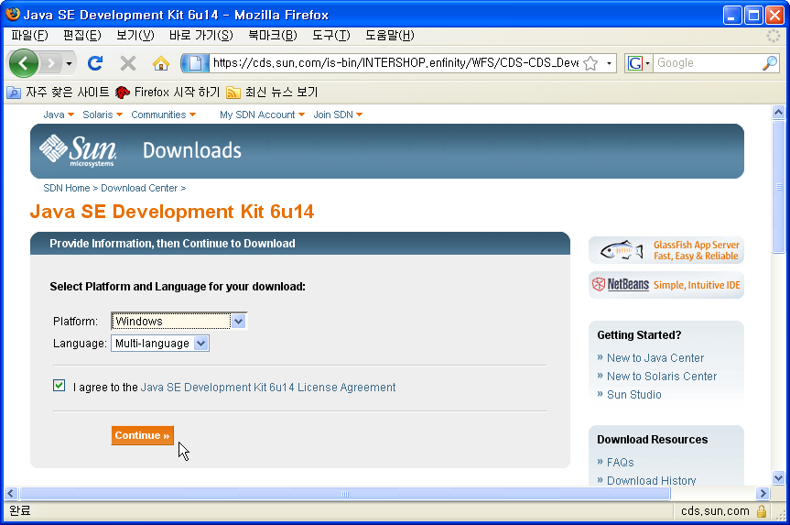
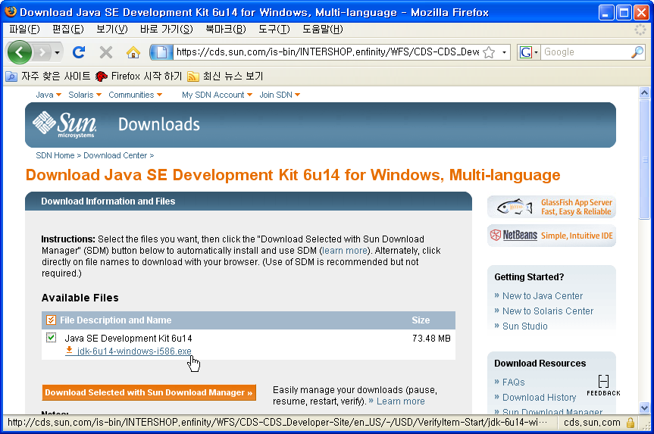
JDK
Download
Platform: Windows
Language: Multi-language
File: jdk-6u14-windows-i586.exe

Slide 5

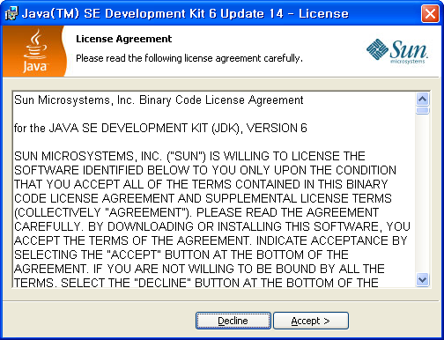
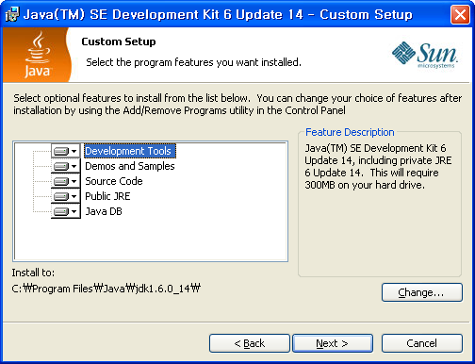
JDK
Install
Install Directory
  C:\Program Files\Java\jdk1.6.0_14\

Slide 6
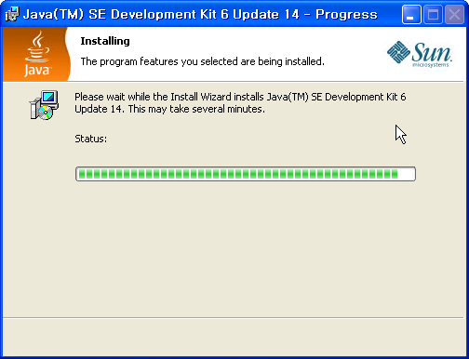
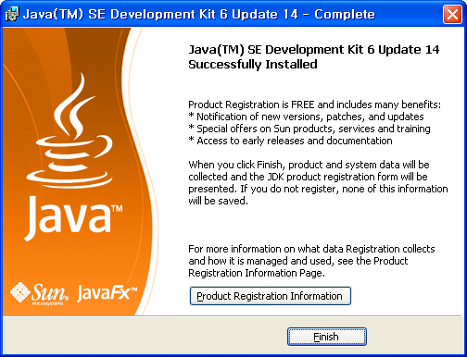
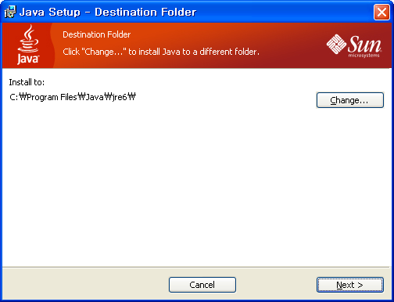
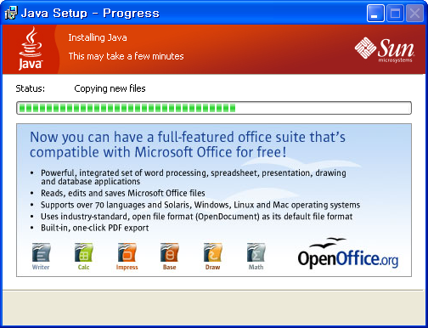
JDK
Install
Install Directory
  C:\Program Files\Java\jre6

